Slide 1
Catholic Schools – Communities of Service
Friday: Service in our Faith Communities
Notes:
This material contained here is most suitable for senior students but could be adapted for use with junior students also. It includes an opening prayer. There is quite a lot of material here; adapt it to the length of class time you have.
This is the material for Friday of Catholic Schools Week. It follows the other themes organically and should be used in conjunction with them.
Christian service puts faith into action. In Catholic schools, as we study and look to Jesus Christ as our role model and teacher, we come to a greater understanding of the depth of Christian service. Jesus served every person regardless of creed, background, faith, social status or age. He put faith into action by showing all those around him how our Heavenly Father is compassionate, courageous and forgiving. Jesus didn’t just talk about his faith; he lived it. We are called by faith to go into the world to share the love of God with all those we meet. Each person, at every age, is called to become Christ for another by serving every person with a humble heart and with a generous spirit.
Having looked at service within friendships, within our families, and within our local communities, we now turn to what service in our local faith community might look like in the lives of young people now and into the future.

Slide 2
Learning Outcomes
You will understand your own uniqueness and explore what this means in terms of the concept of ‘vocation’.
You will understand how you can be of service now and into the future in your local faith community.
You will understand the concept of discernment and what that looks like for your life.
You will be able to engage with material that challenges you to consider vocation in a serious way for your own life.

Slide 3
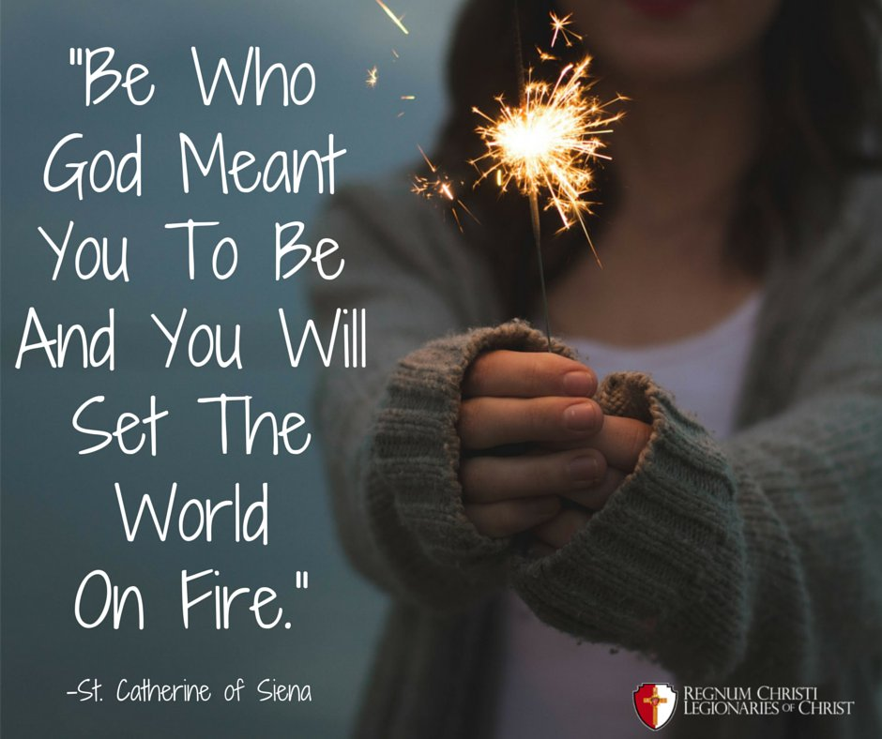
This is how we’ll get there …
By learning together about the importance of a faith community.
By exploring what you can do now and into the future.
By seeing how being of service is good for you.
By having some quiet time and seeing the value of quiet time.
Notes:
It is important in exploring these questions to look at the ‘why’. We are called to take our calling to be part of a faith community seriously because of the belief that Christians have around the kingdom of God. In order to give witness to the kingdom, we are called to be our best and truest selves: to be who God meant us to be. In order words, it’s not just about personal fulfilment but about affecting change in our own lives, in the lives of others, in our communities, in the world and for the good of our common home.

Slide 4
Opening Prayer
Am I necessary?
Notes:
Settle the group as you would for any prayer service.
Begin with something like:
Modern culture influences us to ask ourselves if we important or popular or famous. Our faith asks us to answer with a resounding ‘yes’ to the question ‘Am I necessary?’ Each of us is absolutely necessary; each of us is totally unique and is a miracle. Because of this, we are all called to do something significant within our communities with the great gift we each are.

Slide 5
Notes:
Pope Benedict answers the question very clearly: ‘We are not some casual and meaningless product of evolution. Each of us is the result of a thought of God.’
We are each of us absolutely necessary. But what is it that we are necessary for? We can’t find that answer in noise or on our own; we can only come to an awareness of what it is we’re called to do with our lives in deep stillness because it is in deep stillness we meet God.

Slide 6
Opening Prayer
Notes:
This is a beautiful hymn by the musician Travis Green.
See: https://www.youtube.com/watch?v=qjl7X-N6_do.
Let’s listen and begin to enter into that quiet place where we can begin to answer the question, ‘What am I being called to do with the miracle that is my own very unique life and all the gifts that I have been given?’

Slide 7
Notes:
You might take a moment here to light a candle as part of the opening prayer and to have a moment of quiet.
‘We light this candle inviting us into an awareness that God guides us through our learning together today, inviting us into deep friendship and relationship with Father, Son and Spirit. It is in this relationship of love that we believe we will find our ultimate purpose, meaning and fulfilment. Lord be with each of these wonderful students in their learning. We make this prayer through Christ our Lord. Amen.’
(You can add your school crest here and say a few words about your school as a faith community that supports you as you discern what it is God is calling you to do with the miracle that is your life.)

Slide 8
‘Tell me what it is you plan to do with your one wild and precious life?’
As we conclude our prayer we listen now to the words of the poet Mary Oliver.
Notes:
Video Link: https://youtu.be/rBPHUE961zI
You can share the text of this poem with students and get a student to read out the poem if you’d prefer.
‘The Summer Day’ – Mary Oliver
Who made the world?
Who made the swan, and the black bear?
Who made the grasshopper?
This grasshopper, I mean--
the one who has flung herself out of the grass,
the one who is eating sugar out of my hand,
who is moving her jaws back and forth instead of up and down --
who is gazing around with her enormous and complicated eyes.
Now she lifts her pale forearms and thoroughly washes her face.
Now she snaps her wings open, and floats away.
I don't know exactly what a prayer is.
I do know how to pay attention, how to fall down
into the grass, how to kneel down in the grass,
how to be idle and blessed, how to stroll through the fields,
which is what I have been doing all day.
Tell me, what else should I have done?
Doesn't everything die at last, and too soon?
Tell me, what is it you plan to do
With your one wild and precious life?

Slide 9
Our lesson today will be broken up into two main parts:
The Present
The Future
What can I do now in service of my faith community and the world?
How does service help me and others?
Give an example.
What might I be called to do in the future in service of my faith community and the world?
What does it mean?
Give an example.

Slide 10
But before we do that let’s look at some important concepts we’ll be engaging with …
To the right are some of the terms we’ll be working with on this topic.
Community
Discernment
Vocation
Service
Faith Community
Deep Listening
Notes:
Provide cut out flash cards of each of these terms. Ask students to work together in small groups to define each of these words.
As a larger group, share these definitions. Unpack for a few moments any challenges around these words. (Re-assure students that we’ll be looking at them in greater detail and come back to them at the end of the class to explore further). However, obviously any one of these words could be a lesson in and of itself!

Slide 11
Part 1
What can I do now in service of my faith community? And why should I?

Slide 12
Well-being, purpose and connection
Notes:
This Mental Health Ireland video is available at: https://youtu.be/bsc2QkCC3uI
Divide the class into groups. Give each group a different term to focus on:
Take Notice
Connect
Give
Keep Learning
(Leaving out ‘Be Active’ for the purposes of this class lesson makes sense, but you can also include it if you wish.)
Each group will explore their term using these questions:
What does this word/term mean to you?
How are you as young people doing this now in our own life?
How could you do more?
What about your local parish? Is the word/term you’re looking at relevant to how you could help in your local parish? In what way is it relevant? In what way is it not?

Slide 13
For example – Service now
Notes:
Video link: https://www.youtube.com/watch?v=wn741o80SmY
Use these higher and lower order questions to help unpack this video:
What kinds of things can young people do in their parish to get the Award shown in the video?
What other kinds of things can they do as part of their social outreach?
What do young people get at the end of doing the Award?
Who is the Award named after?
What are the benefits of doing the Award according to the two young people interviewed?
Look back at the four terms we explored. How might doing the John Paul II Awards help in terms of well-being and working and being part of your faith community? The terms were as follows:
Take Notice
Connect
Give
Keep Learning
Who would you contact if you wanted to help out in your local parish community?
Note: Your school may do the John Paul II Awards. If so, you can speak directly to this experience. Depending on your group, you might discuss how class members have helped out in their parish in the past and continue to do so.

Slide 14
Part 2
To what am I being called in the future?
Notes:
How do we feel about climate change and our relationship with planet Earth?

Slide 15
Part 2 – Vocation
Notes:
Explore what this quotation might mean.
You might spend a few moments in discussion using the following questions:
What is the difference or similarity between listening to your call to a vocation and a career choice? Is there a difference?

Slide 16
‘Tell me what it is you plan to do with your one wild and precious life?’
Notes:
We are all called to holiness, but that holiness can take on different expressions depending on the specific call we’ve been given:
Single Life
Priesthood
Married Life
Religious Life
(You can spend some time explaining the differences here and getting the students’ sense of the differences. What’s important is to land on a sense that each is important and each has a role to play.)
In addition, even within those four specific expressions of holiness, we are further called to explore what specifically that might look like, for example within priesthood, is it diocesan priesthood, or is it a vocation within a religious order? And even within that might be a particular role you’re called to, for example in religious life to be a religious sister or brother working in education or in health care.
Here is a short summary of the four types of vocations (from the Archdiocese of Chicago website, https://vocations.archchicago.org/what-is-a-vocation):
(If you have more time and think your students would respond well to it, there’s a video from this websitethat explains vocation within the context of the universal call to holiness, available at https://youtu.be/fWxnG-O7OvY. You can use that to supplement this section.)
Through the sacrament of baptism, we all have one calling in our lives: holiness. This means following Jesus to the best of our abilities. However, holiness will look different depending on one’s specific vocation. It’s important to listen and recognize the signs that determine how one answers and finds a place in life. There are four distinct types of vocations in the Church.
Religious Life – Commitment in life to live as Christ lived through vows of poverty, chastity and obedience.
Priesthood – Conformed to Jesus Christ through the sacrament of holy orders, priests are called to be chosen instruments in the world.
Married Life – Faithful commitment to each other consecrated by the sacrament of holy matrimony, they strive to please God through their devotion to each other and building a faith driven family.
Single Life – Commit in life to serve others in their work and prayer.

Slide 17
Changing times….
What about the future? A video from World Youth Day
Complete the work sheet as you watch this video and then discuss your answer in pairs.
Notes:
Video link: https://youtu.be/JeOUMeLKQRQ
Work sheet text:
Give the questions out in advance as the video is playing and allow the students to complete the questions as they watch the video. (Question 4 – 6 can be answered on completion of the video as they will require more thinking time.) Allow the students to share their answers in pairs.
What is World Youth Day?
What kind of fair was held in the centre of Lisbon as part of World Youth Day?
What does the word ‘Vocation’ mean? How it is connected to baptism?
What words would you use to describe the attitude of the young people to their faith in this short video?
What is Pope Francis’ key message on vocation? Where does it begin?
The word ‘discernment’ is often used when people talk about finding their calling. After watching this video, what do you think this word means in the context of what the video is saying about finding your vocation?

Slide 18
For example:
Notes:
Fr Philip Mulryne OP video available at: https://www.youtube.com/watch?v=sJ4NnPz-sZM
Introduce the video by exploring the difference here in Fr Philip’s life between having a career, in this case as a professional footballer, and a vocation, in this case as a Catholic priest.
After showing the video, ask students to discuss the following (either in small groups or as part of a larger group):
What words would you use to describe Fr Philip’s decision to follow his calling?
Was it a hard decision?
What helped him make that decision?
What benefits have come to him as a result of his answering of his call?
What benefits do priests bring to local community in terms of the work they do?
What age do you think is too young or too old to answer a religious vocation?
Do you know where someone might go to get more information if they were interested in becoming a religious sister or a priest?

Slide 19
Connecting Part 1 and Part 2
Having spent some time exploring these themes, what do these terms mean to you now?
What word/term spoke most to you and why? Share with the person sitting beside you and then with the class, if you wish.
Community
Discernment
Vocation
Service
Faith Community
Deep Listening

Slide 20
Connecting Part 1 and Part 2
Notes:
Art activity (optional):
Ask students to take a few moments to respond to what they have learned about vocation and service (perhaps playing quiet music in the background).

Slide 21
Closing reflection
May today there be peace within. May you trust God that you are exactly where you are meant to be. May you not forget the infinite possibilities that are born of faith. May you use those gifts that you have received, and pass on the love that has been given to you May you be confident knowing you are a child of God. Let this presence settle into your bones, and allow your soul the freedom to sing, dance, praise and love. It is there for each and every one of us.
Notes:
This poem is occassionally attributed to St Thérèse of Lisieux, St Teresa of Ávila or poet Minnie Louise Haskins.

