Slide 1
Notes:
All images from Pixabay (Free to use)
Slide 4 – Church/gathering https://pixabay.com/photos/marketplace-parish-church-st-jacobus-2678507/
Slide 5 – Homelessness https://pixabay.com/photos/homeless-blankets-charity-poverty-2090507/
Slide 6 – Ukraine boy https://pixabay.com/photos/ukraine-flag-little-boy-destruction-7068221/
Slide 8 – Environment https://pixabay.com/photos/environmental-protection-326923/
Slide 7 – Inside church https://pixabay.com/photos/church-architecture-inside-7590395/

Slide 2
Thursday: Service in
our Local Community

Slide 3
The Community and Service

Slide 4
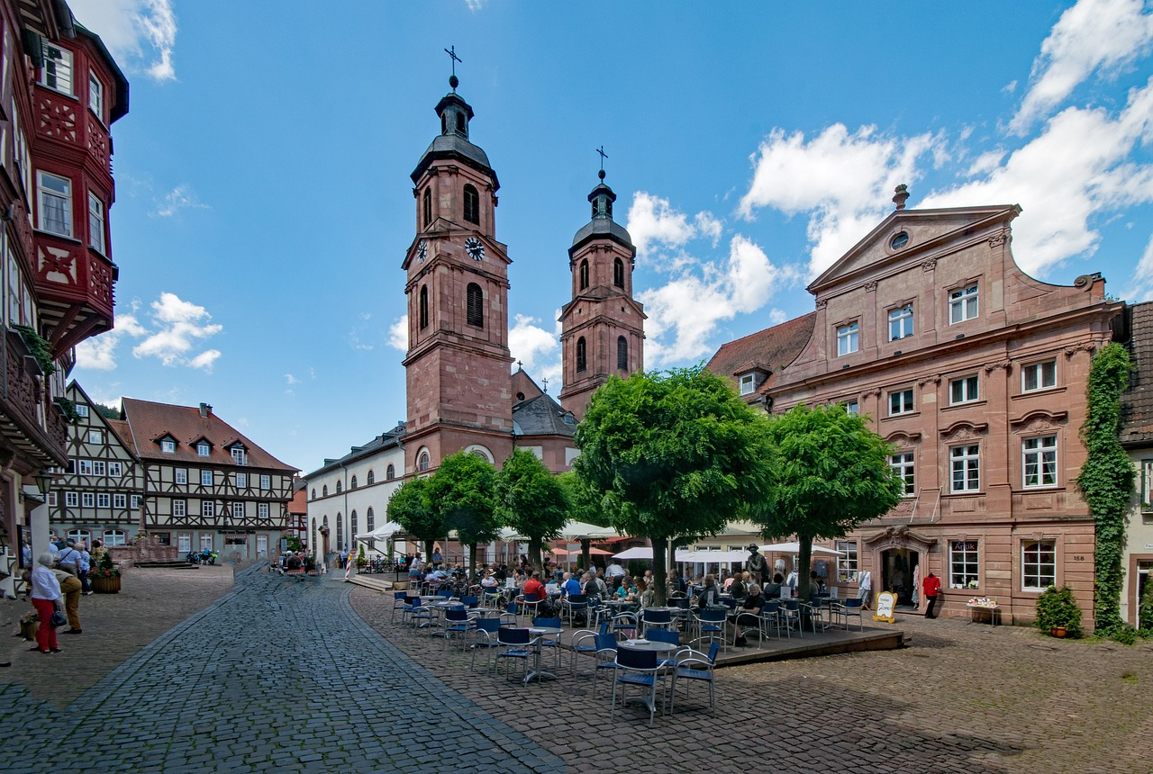
People gather in their local communities.
Why gather together?

Slide 5
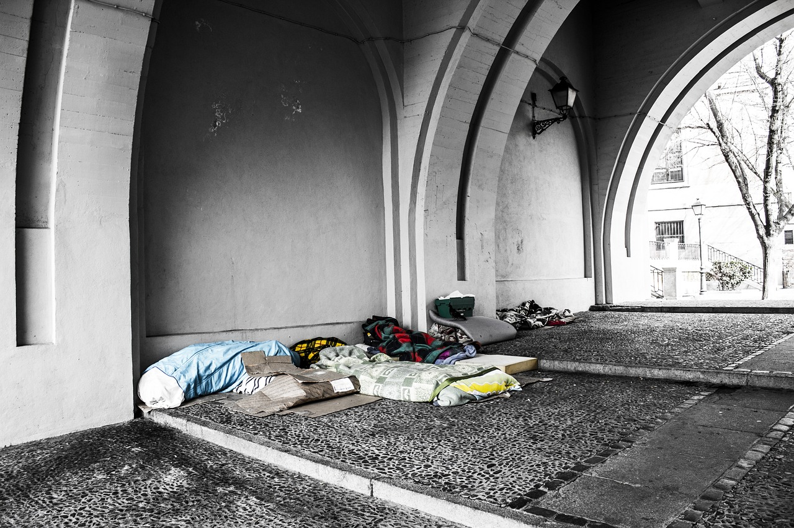
The parish community can promote social justice. How?

Slide 6
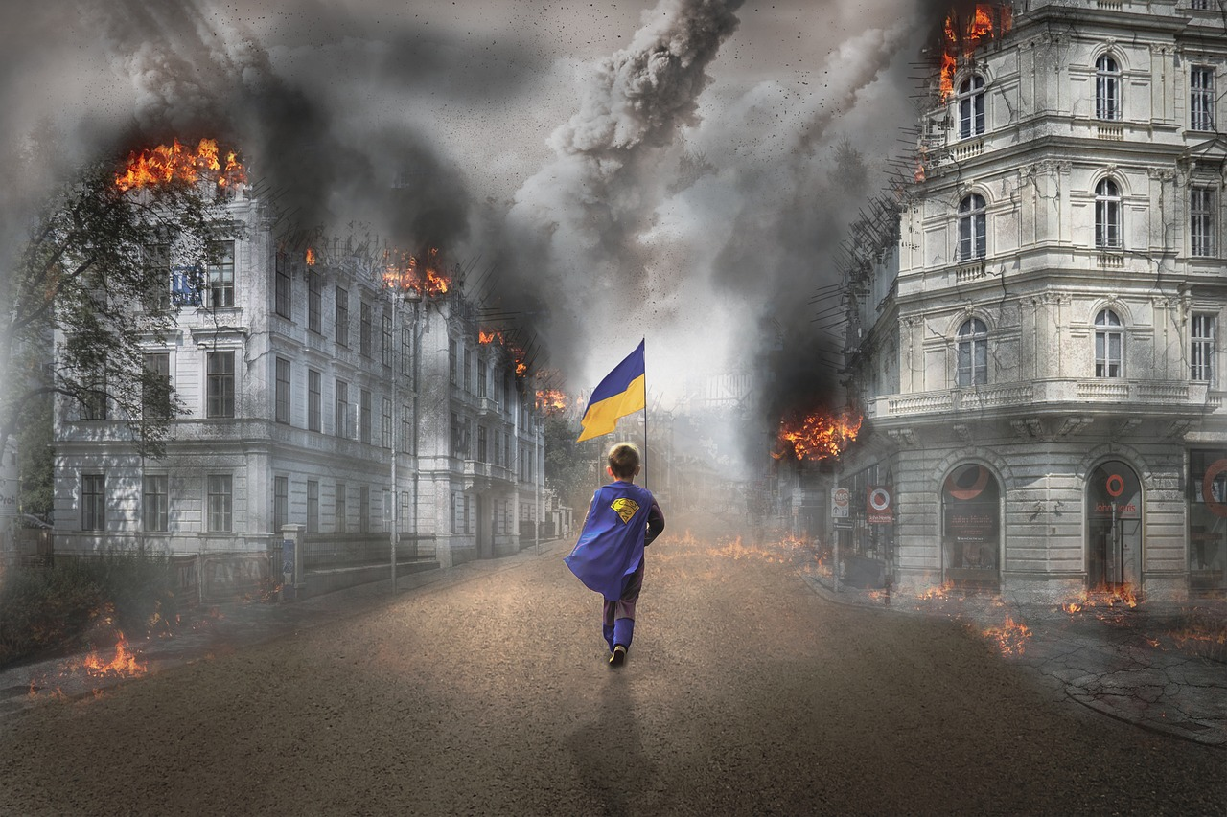
The parish community can respond to current needs and issues. Give an example of how.

Slide 7
Parish communities can be affected by environmental concerns. How might this be?

Slide 8
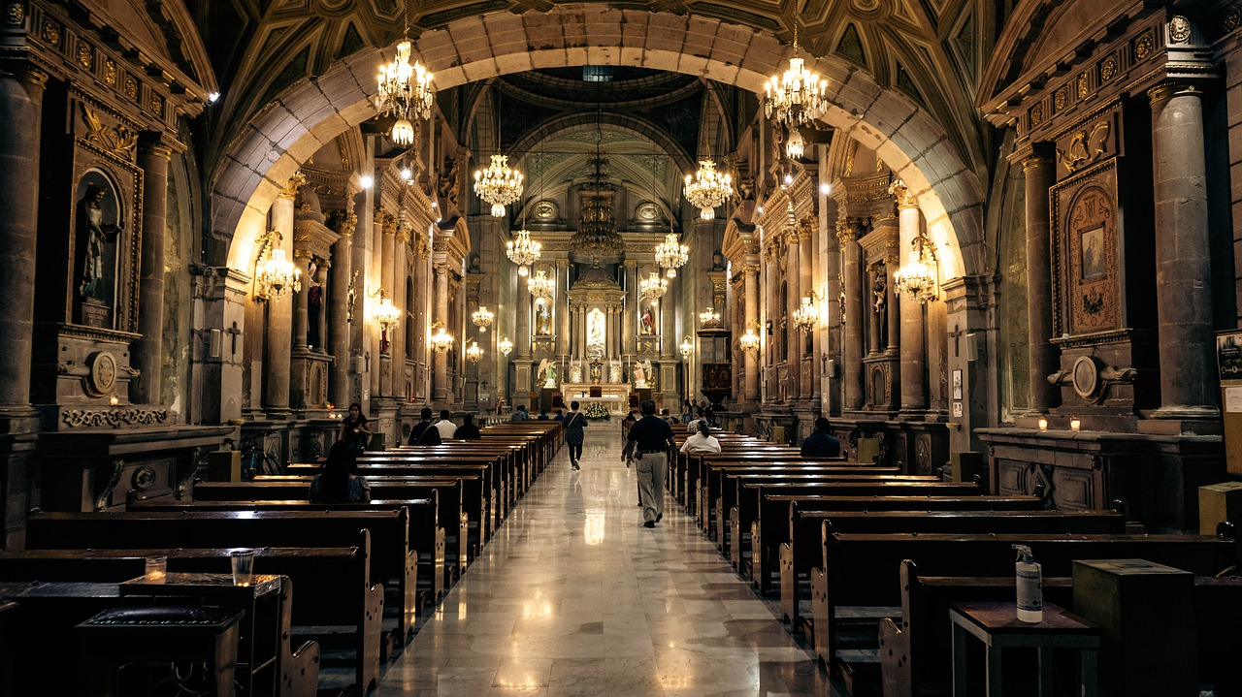
Parish communities gather for happy and sad occasions. Give some examples of this.

Slide 9
‘What a Wonderful World’ – Playing for Change
Notes:
Link to YouTube video: https://www.youtube.com/watch?v=ddLd0QRf7Vg

